Slide 1

Forecasting Economic And Financial Time Series: ARIMA vs. LSTM
Teammates
Upamanyu Pathare
Yutao Shu
Yongsheng Liu
Hexin Xu
Bolun Deng

Slide 2
Background
We’re evaluating the merits of the paper’s comparative approach to estimating/predicting financial time series using LSTM vs. ARIMA models.
The paper used an ARIMA(5,1,0) model as a baseline to estimate stock index (and stock) levels over time.
As an improvement, it proposed a simple LSTM model with 1 dense layer and an Adam optimizer.
The authors reported a 70-90% improvement based on their primary metric of Root Mean Square Error between actual and predicted values of the stock index levels.
Our group proceed to evaluate the merit of this claim with particular focus on whether this approach had any merit from a trading strategy perspective.

Slide 3
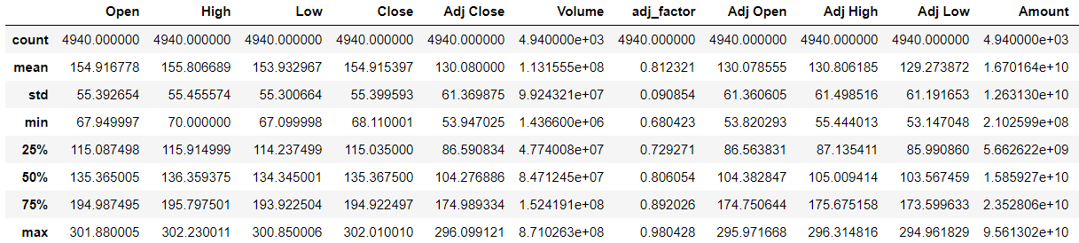
Setup
The data used for the model was the daily adjusted closing price for the State Street S&P 500 Index ETF (NYSE: SPY).
We have about 4940 days of data spanning from January 2000 to August 2019.
For simplicity, we reserved the final 1200 observations for the test set and used the first observations 3740 for the training.
As in the paper, we found that the data was non-stationary and first differencing it yielded a stationary dataset; justifying the paper’s use of a single integration term in the ARIMA.

Slide 4
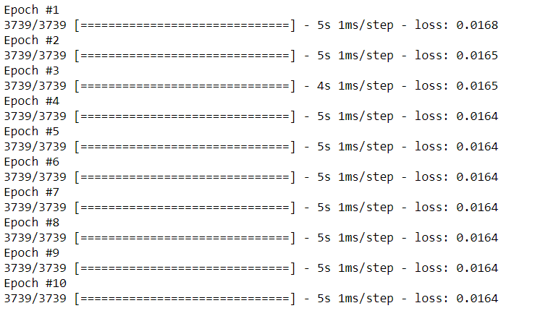
Results
After running the regressions and trainings, we discovered that the paper’s claims about reduction of RMSE were dubious at best.
Our first point of concern was with the training itself. We observed that the number of training epochs had little effect on the training loss.
This concerning finding is actually in line with what the authors of paper found as well. The implication seems to be that the model isn’t really learning much from the data.

Slide 5
Results (contd.)
Furthermore, we were completely unable to replicate the paper’s findings that LSTM reduced the RSME compared to ARIMA.
In fact the RSMEs were very similar: 1.937 for ARIMA and 1.932 for LSTM. Although we did not construct formal confidence intervals around this, we believe it to be small a difference to be significant.
Finally, to evaluate the effectiveness of either model as a trading algorithm, we constructed predicted returns from the level predictions.
We discovered that there was almost no predictive power to the returns, and the best estimate almost always hovered near 0.

Slide 6
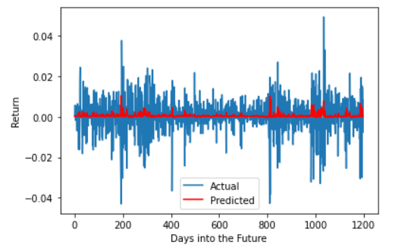
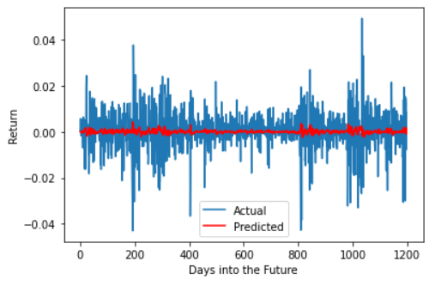
Results (contd.)
LSTM Model
ARIMA Model
To check if we could predict the sign of the return better than value, we used an accuracy metric (proportion of correctly predict signs).
We found that both models performed not significantly better than random noise.
The ARIMA had an accuracy of 50.01% while LSTM had an accuracy of 53%.

Slide 7
Naïve Model
Finally, we obtained an absolutely damning rebuttal of the paper’s results by running a so-called “Naïve Model”.
This model simply predicts tomorrow’s value of the stock/index to be equal to today’s observed value (i.e. predicted one-day return is always 0%).
We observed that this model’s RMSE was also in the same ballpark, about 1.934.
This suggests that’s authors’ claim of being able to successfully reduce prediction error using RMSE is highly suspect.

Slide 8
What might have gone wrong
The authors are very coy about their dataset.
They only used about 200-300 samples for most of their training jobs, without explaining too well when and how these samples were picked.
Little attempt was made to incorporate additional features such as volume, spreads, volatility etc.
It would indeed have been surprising if returns or levels could be significantly predicted (superior to the naïve approach) with just previous days’ values.

Slide 9
Some Improvements
LSTM forecast return
A Little More Features: OHLCV
A Deeper Network

Slide 10
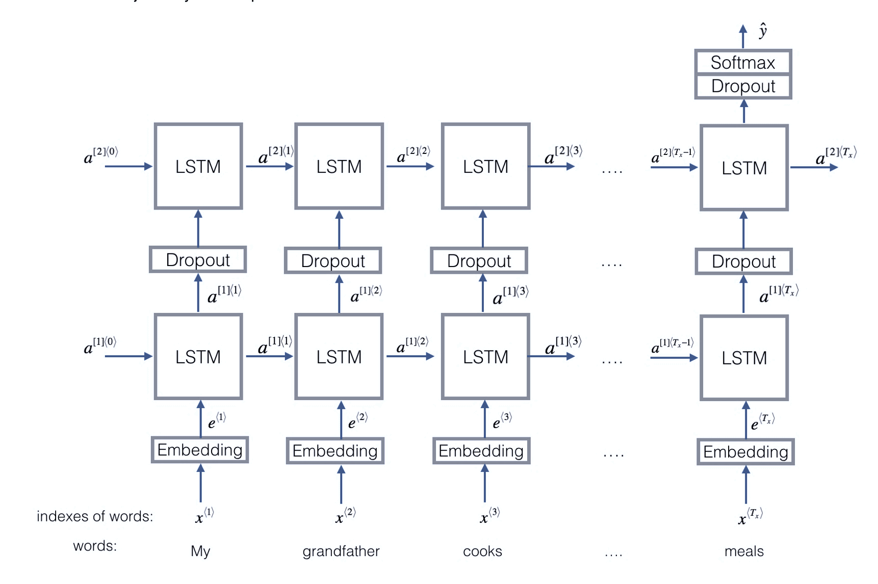
Basic Framework
Input: a time series of past price & volumes, (#sample, T=20, #feature=5)
Output: prediction of next day’s return
Loss function: MSE

Slide 11

Data Standardization
Standardize Price:
Divided by close 21 days ago [$\frac{{open}_{t−20}}{{Close}_{t−21}}$, $\frac{{open}_{t−19}}{{Close}_{t−21}}$,…, $\frac{{open}_{t−1}}{{Close}_{t−21}}$]
Same for High, Low, Close
Standardize Amount:
Divided by average amount in past 50 days

Slide 12
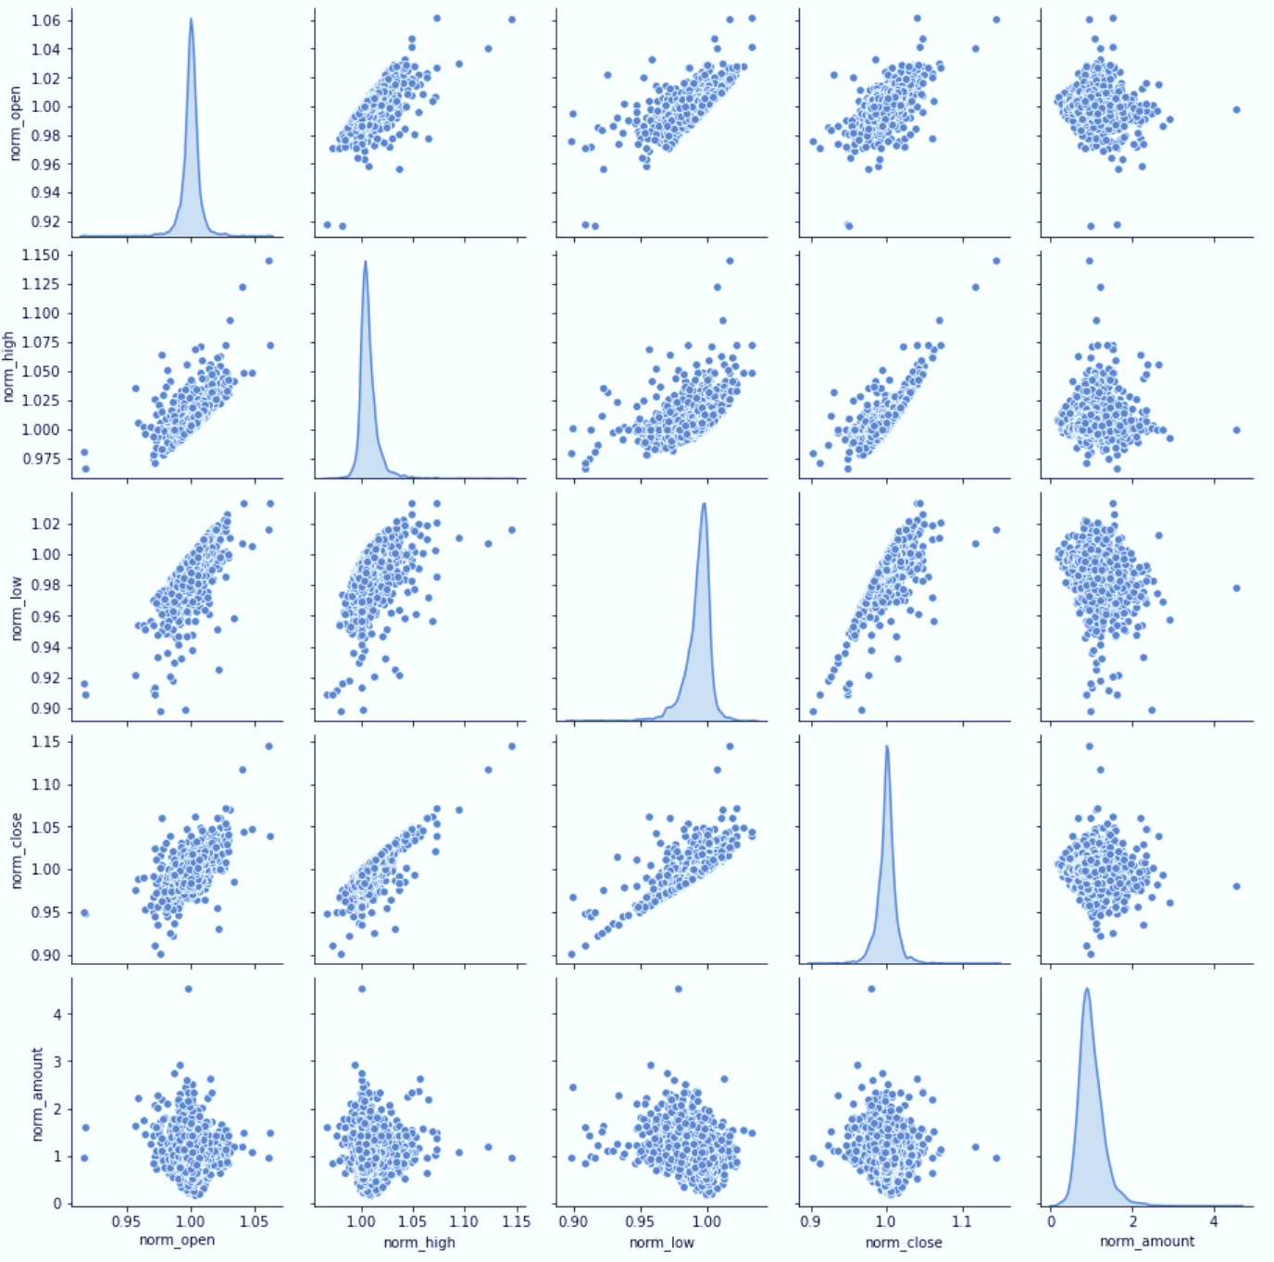
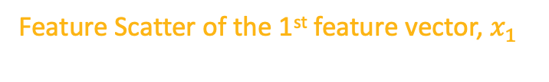
Data Standardization
Feature Scatter of the 1st feature vector, $x_{1}$

Slide 13
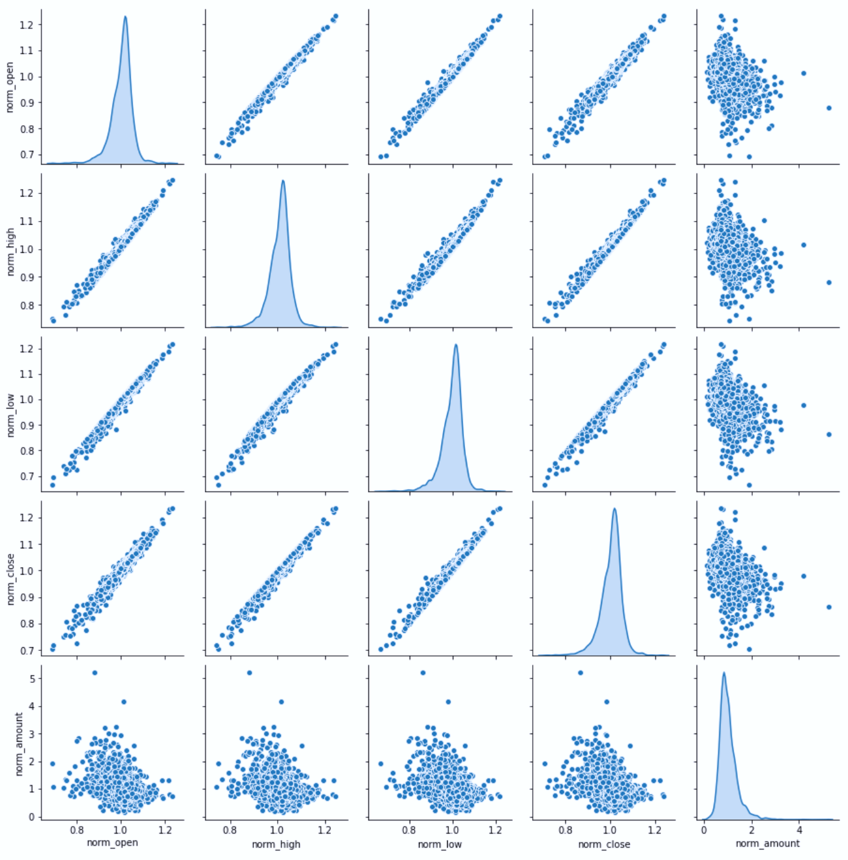
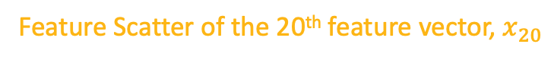
Data Standardization
Feature Scatter of the 20th feature vector, $x_{20}$

Slide 14
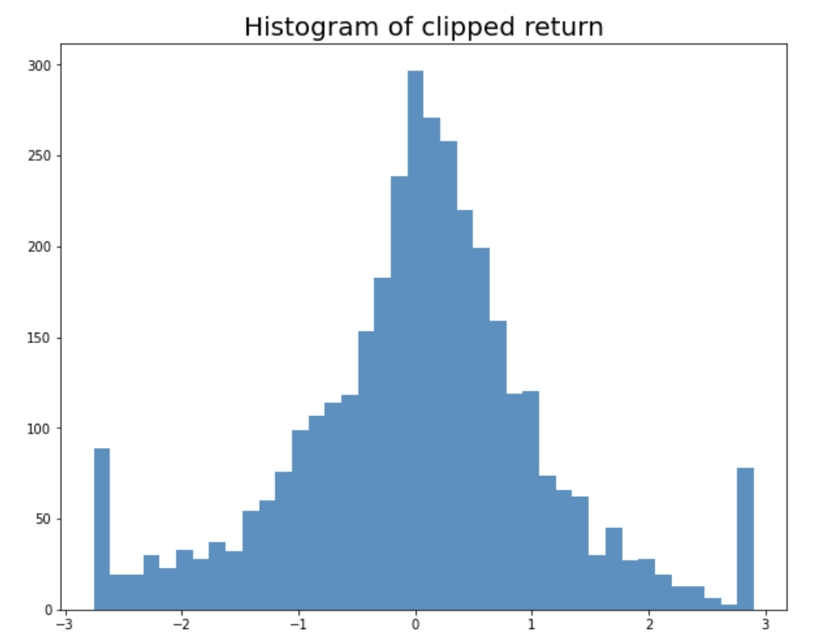
Data Standardization
MSE is sensitive to outliers, so we clip the return data as the training labels
sklearn.preprocessing.RobustScaler()
Histogram of training labels

Slide 15
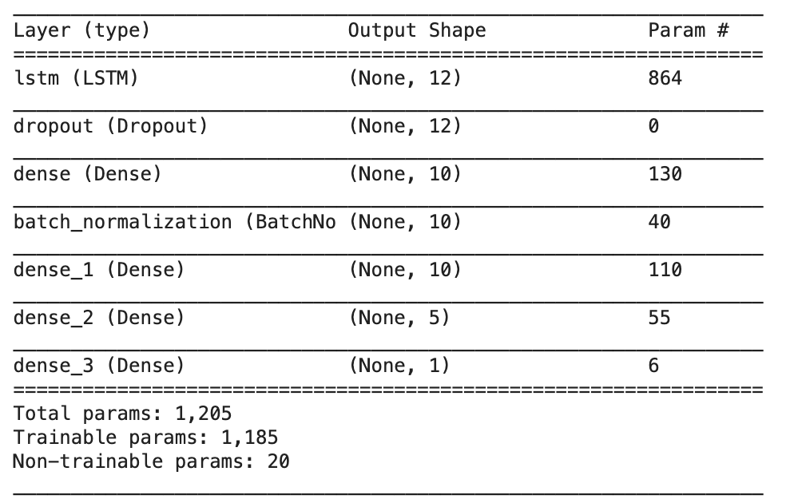
Training Model 1
LSTM + 4 Dense
NN Architecture

Slide 16
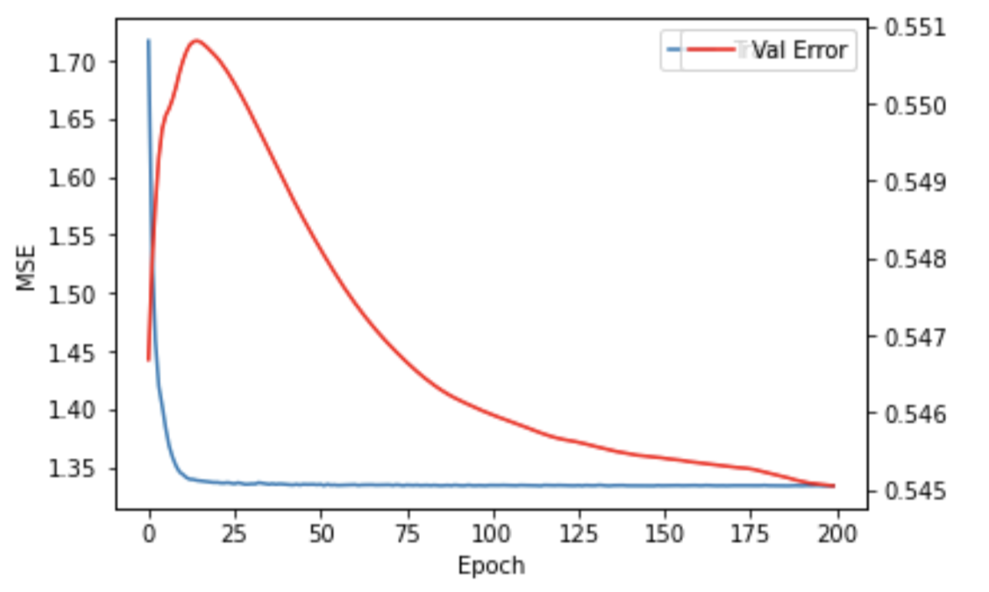
Training Model 1
LSTM + 4 Dense
Training Curve

Slide 17
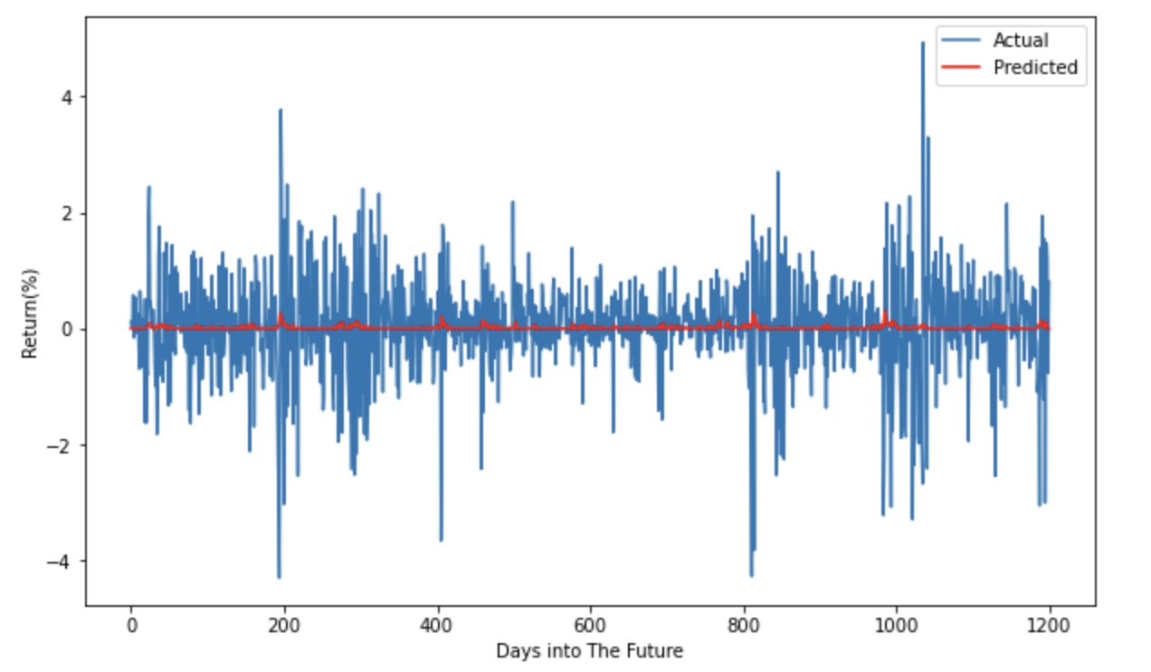
Training Model 1
LSTM + 4 Dense
Predictions

Slide 18
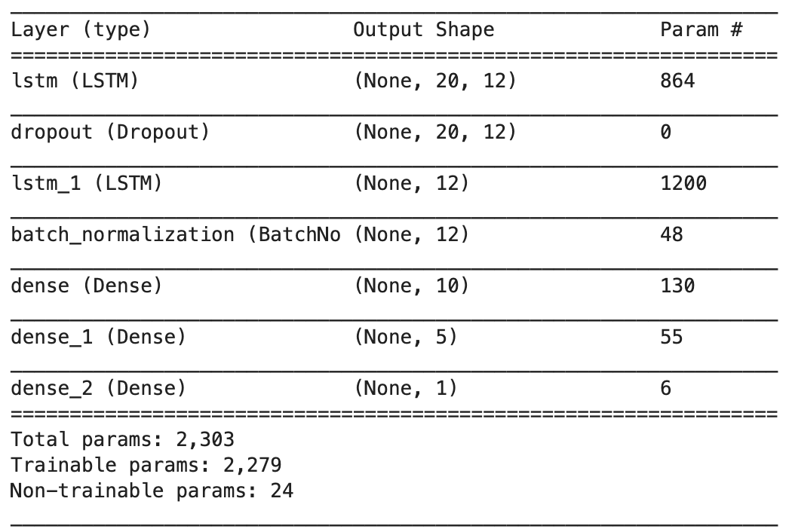
Training Model 2
Double-LSTM + 3 Dense
NN Architecture

Slide 19
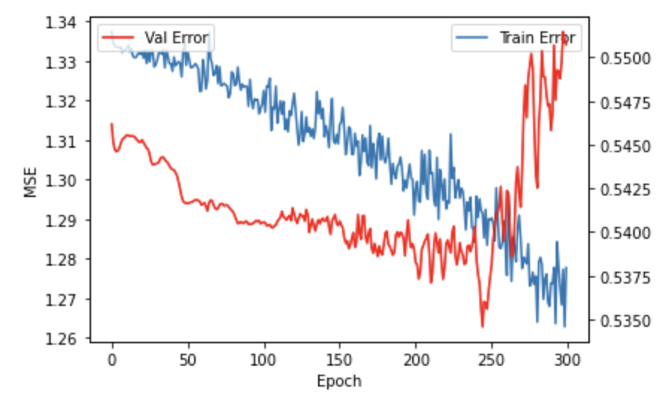
Training Model 2
Double-LSTM + 3 Dense
Learning Curve

Slide 20
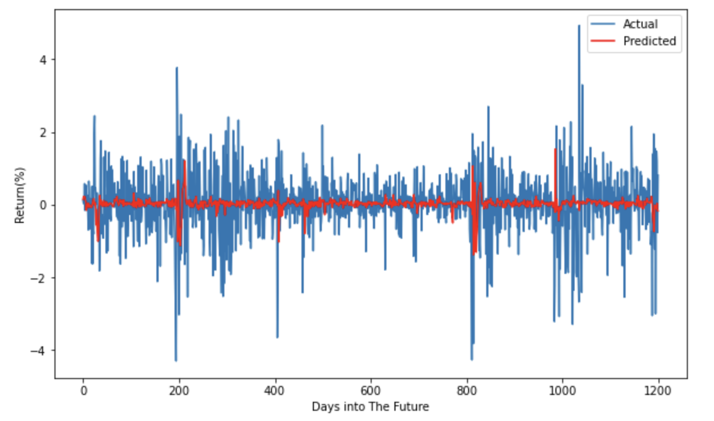
Training Model 2
Double LSTM + 3 Dense
Predictions

Slide 21
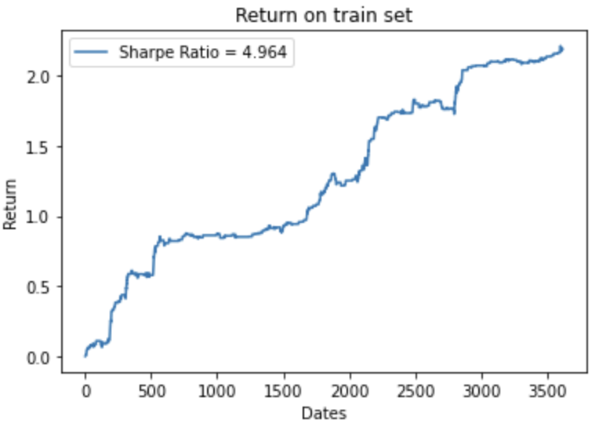
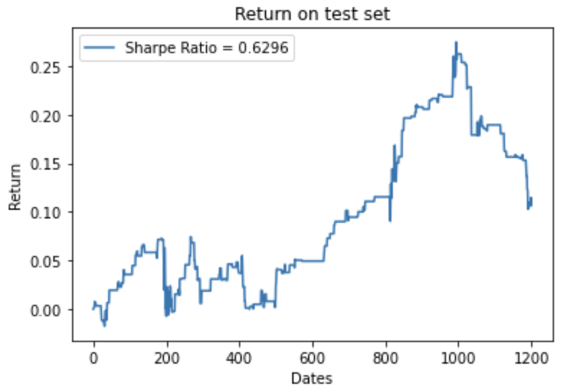
Training Model 2
Double LSTM + 3 Dense
Evaluation: A simple trading strategy performance
(Long when prediction > 0.1, short when prediction < 0.1)

Slide 22
Training Model 2
Double LSTM + 3 Dense
 | Null Predictor | Model 1 | Model 2
MSE (%) | 0.7384 | 0.7392 | 0.7693
MAE (%) | 0.5886 | 0.5886 | 0.5996
 |  | Underfitting | Overfitting
Evaluation

Slide 23
Future Improvements
LSTM forecast return
More data: 1-min frequency BTC/USD data
Feature Engineering
Classification vs Regression

Slide 24
Thank you!
References
Sima Siami Namini, Akbar Siami Namin (2018) Forecasting Economics and Financial Time Series: ARIMA vs. LSTM. https://arxiv.org/abs/1803.06386
Bao W, Yue J, Rao Y (2017) A deep learning framework for financial time series using stacked autoencoders and long-short term memory. PLoS ONE 12(7): e0180944.
https://doi.org/10.1371/journal.pone.0180944
Aniruddha Dutta, Saket Kumar and Meheli Basu (2020) A Gated Recurrent Unit Approach to Bitcoin Price Prediction . Journal of risk and financial management. https://arxiv.org/abs/1912.11166

